Slide 1


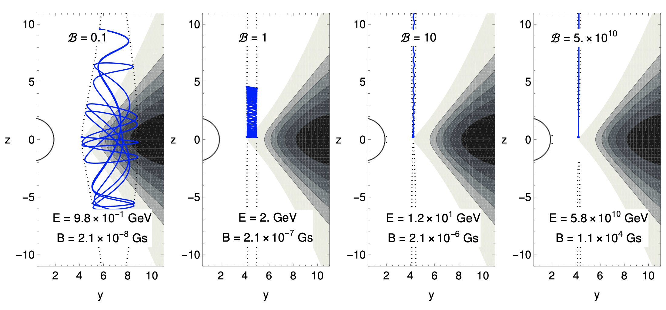
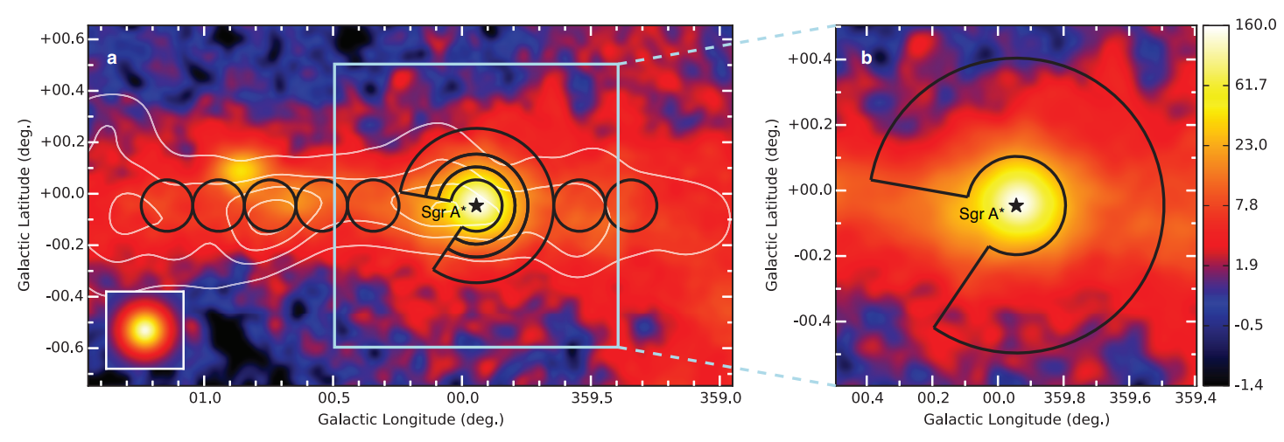
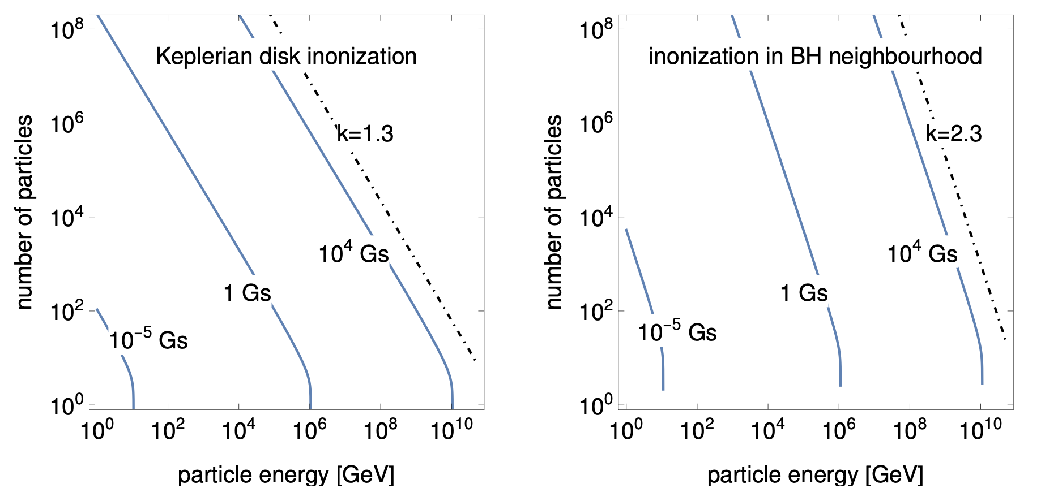
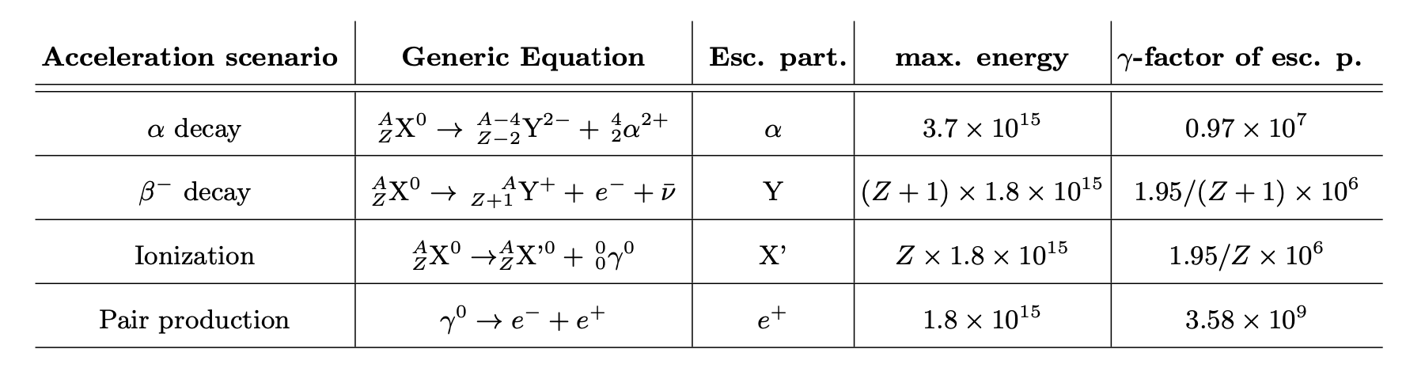
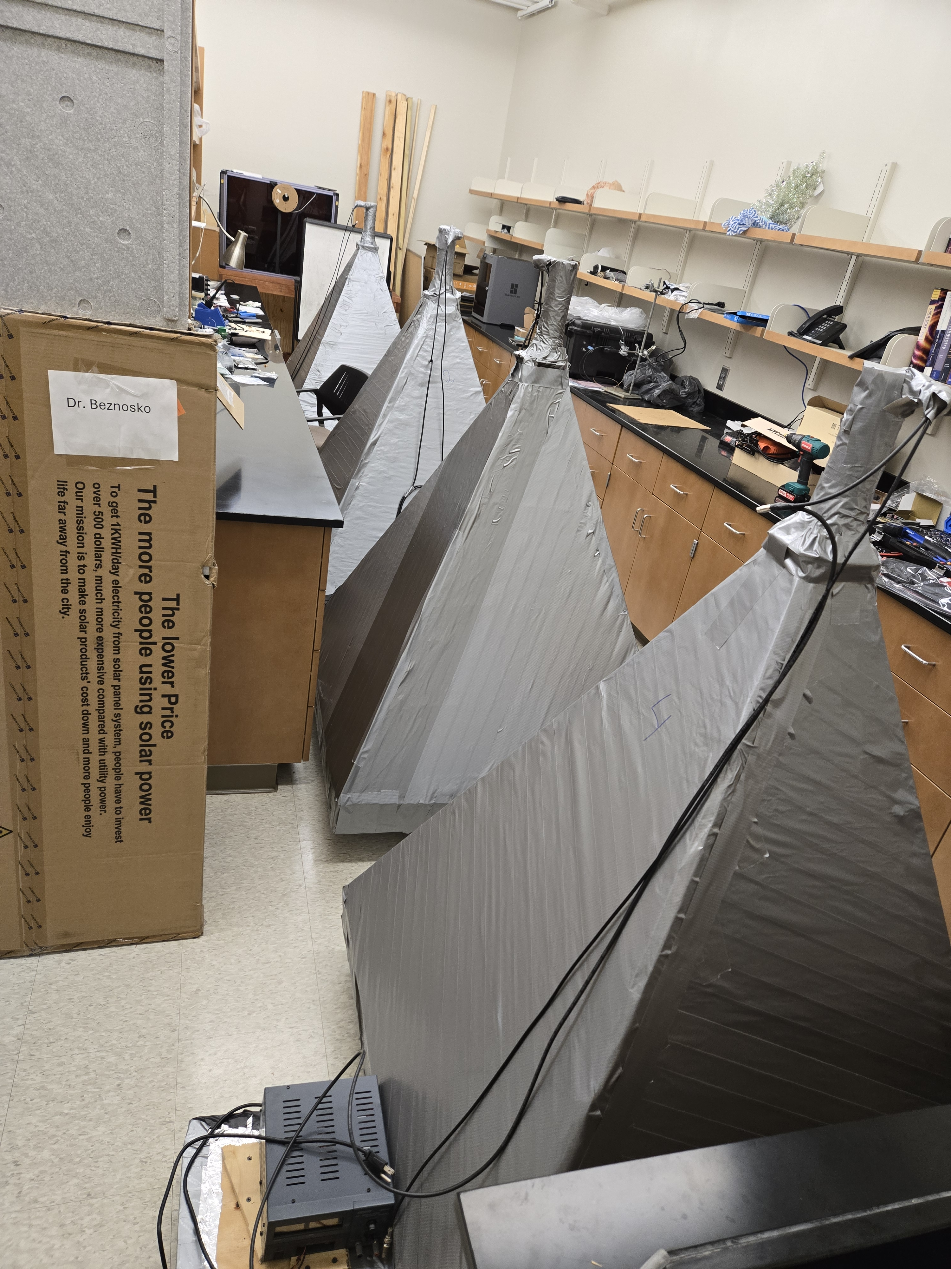
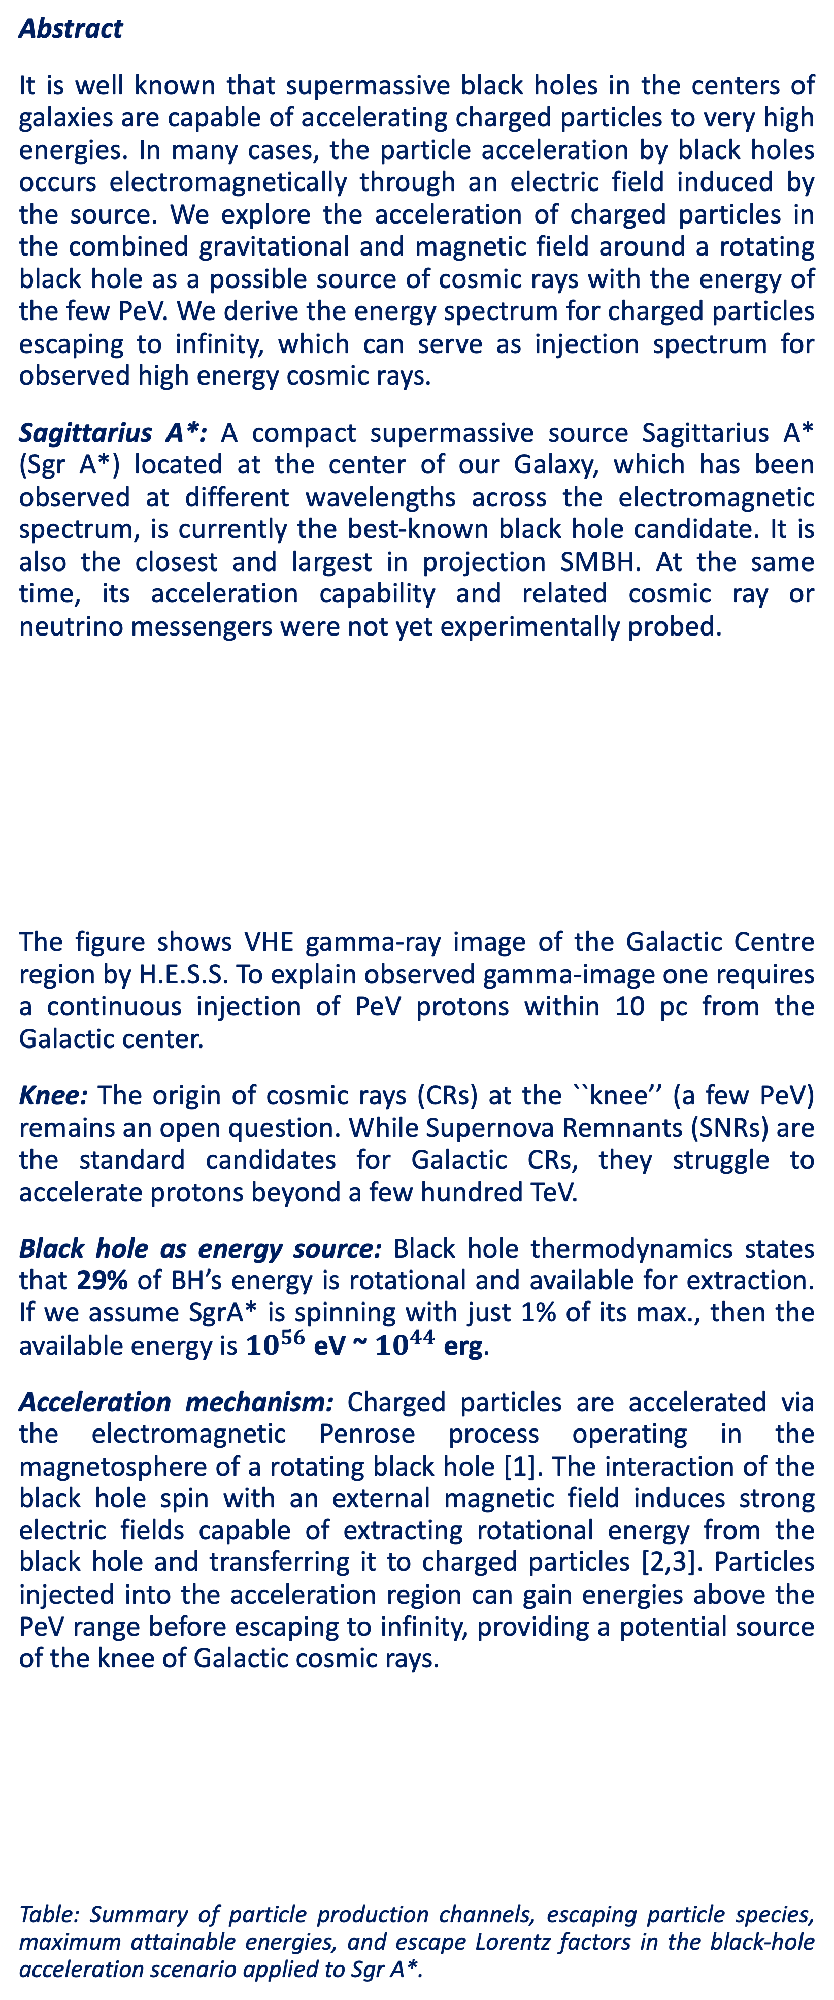
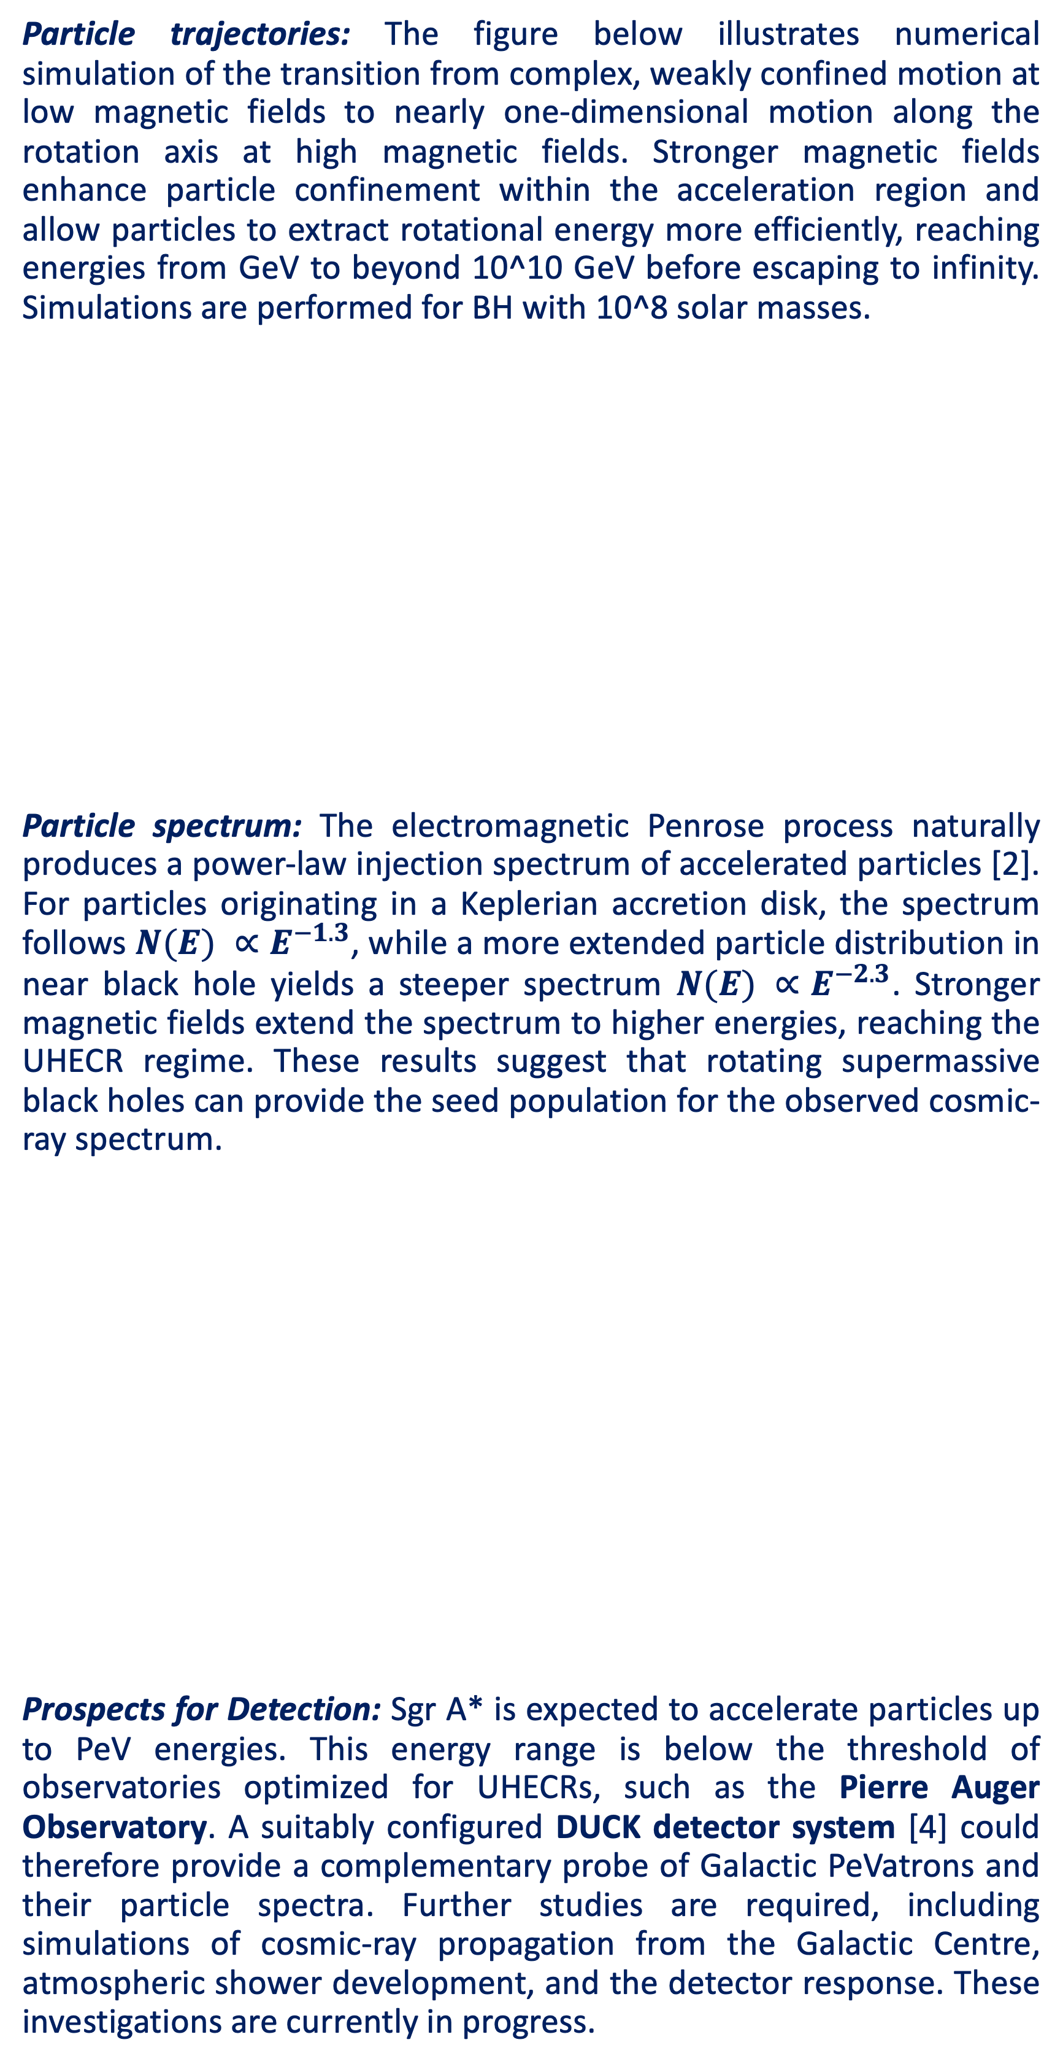
A possible origin of the ‘knee’ in the cosmic rays spectrum due to the Galactic center black hole
Arman Tursunov* (Silesian University in Opava, Czechia) & Dmitry Beznosko (Clayton State University, USA)
* armantursun@gmail.com
Abstract
It is well known that supermassive black holes in the centers of galaxies are capable of accelerating charged particles to very high energies. In many cases, the particle acceleration by black holes occurs electromagnetically through an electric field induced by the source. We explore the acceleration of charged particles in the combined gravitational and magnetic field around a rotating black hole as a possible source of cosmic rays with the energy of the few PeV. We derive the energy spectrum for charged particles escaping to infinity, which can serve as injection spectrum for observed high energy cosmic rays.
Sagittarius A*: A compact supermassive source Sagittarius A* (Sgr A*) located at the center of our Galaxy, which has been observed at different wavelengths across the electromagnetic spectrum, is currently the best-known black hole candidate. It is also the closest and largest in projection SMBH. At the same time, its acceleration capability and related cosmic ray or neutrino messengers were not yet experimentally probed.
The figure shows VHE gamma-ray image of the Galactic Centre region by H.E.S.S. To explain observed gamma-image one requires a continuous injection of PeV protons within 10 pc from the Galactic center.
Knee: The origin of cosmic rays (CRs) at the ``knee’’ (a few PeV) remains an open question. While Supernova Remnants (SNRs) are the standard candidates for Galactic CRs, they struggle to accelerate protons beyond a few hundred TeV.
Black hole as energy source: Black hole thermodynamics states that 29% of BH’s energy is rotational and available for extraction. If we assume SgrA* is spinning with just 1% of its max., then the available energy is ${10}^{56}$eV ~ ${10}^{44}$ erg.
Acceleration mechanism: Charged particles are accelerated via the electromagnetic Penrose process operating in the magnetosphere of a rotating black hole [1]. The interaction of the black hole spin with an external magnetic field induces strong electric fields capable of extracting rotational energy from the black hole and transferring it to charged particles [2,3]. Particles injected into the acceleration region can gain energies above the PeV range before escaping to infinity, providing a potential source of the knee of Galactic cosmic rays.
Table: Summary of particle production channels, escaping particle species, maximum attainable energies, and escape Lorentz factors in the black-hole acceleration scenario applied to Sgr A*.
Particle trajectories: The figure below illustrates numerical simulation of the transition from complex, weakly confined motion at low magnetic fields to nearly one-dimensional motion along the rotation axis at high magnetic fields. Stronger magnetic fields enhance particle confinement within the acceleration region and allow particles to extract rotational energy more efficiently, reaching energies from GeV to beyond 10^10 GeV before escaping to infinity. Simulations are performed for BH with 10^8 solar masses.
Particle spectrum: The electromagnetic Penrose process naturally produces a power-law injection spectrum of accelerated particles [2]. For particles originating in a Keplerian accretion disk, the spectrum follows $N(E) ∝E^{−1.3}$, while a more extended particle distribution in near black hole yields a steeper spectrum $N(E) ∝E^{−2.3}$. Stronger magnetic fields extend the spectrum to higher energies, reaching the UHECR regime. These results suggest that rotating supermassive black holes can provide the seed population for the observed cosmic-ray spectrum.
Prospects for Detection: Sgr A* is expected to accelerate particles up to PeV energies. This energy range is below the threshold of observatories optimized for UHECRs, such as the Pierre Auger Observatory. A suitably configured DUCK detector system [4] could therefore provide a complementary probe of Galactic PeVatrons and their particle spectra. Further studies are required, including simulations of cosmic-ray propagation from the Galactic Centre, atmospheric shower development, and the detector response. These investigations are currently in progress.
LV power supply
ADC
HV power supply
PMT
References:
[1] Arman Tursunov et al 2020 ApJ 895 14 DOI 10.3847/1538-4357/ab8ae9
[2] A. Tursunov, M. Kolos, proceedings of RAGtime 23-25, 47, (2023) https://proceedings.physics.cz/wp-content/uploads/2024/01/RAGtime25_online_final.pdf
[3] A. Tursunov, et al., Symmetry 14 (3), 482 https://doi.org/10.3390/sym14030482
[4] D. Beznosko et al. “Construction and calibration of the DUCK (Detector of Unusual casKades) system modules”. PoS(EPS-HEP2025)521, 2026/01/06, https://doi.org/10.22323/1.485.0521
Function generator
WLS Fiber
MPPC
Scintillator
LED

